Slide 1
Drugs and Suicide in Brazil, Chile and Argentina

Slide 2
Agenda
Introduction
Seizure Variation
Suicide rates
The Alcohol
Is there a correlation?

Slide 3
Introduction
The general idea of the Project was to investigate if there were any correlation between the use of drugs and the suicide rates. In the presentation we consider the seizures as an indicator of use. The countries explored was Brazil, Chile and Argentina, as They are the largest populations in the Region.

Slide 4
Seizures by Country

Slide 5
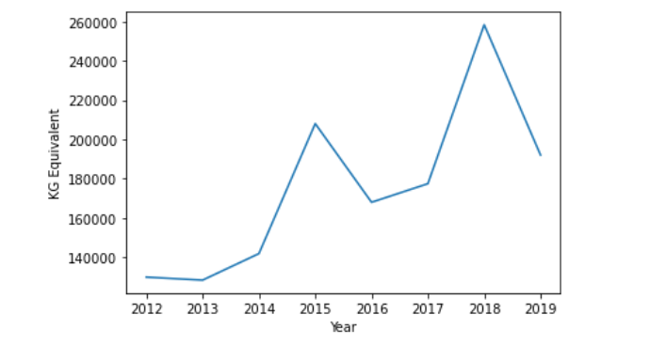
Cannabis seizure in Argentina

Slide 6
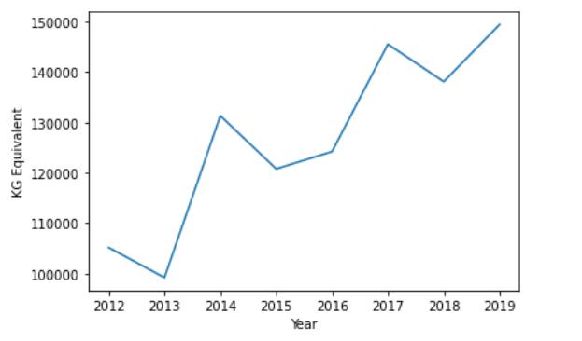
Cocaine in Argentina

Slide 7
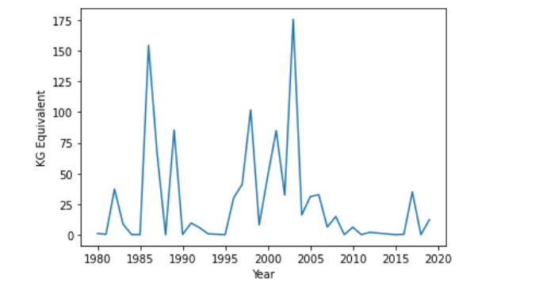
Opioids in Argentina

Slide 8
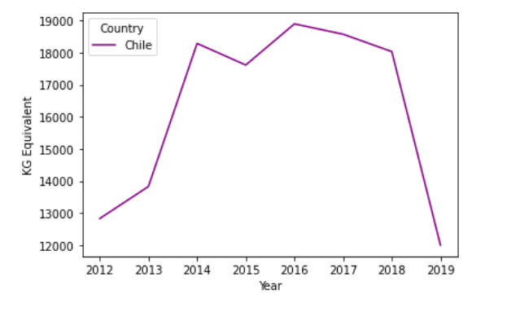
Cocaine seizure in Chile

Slide 9
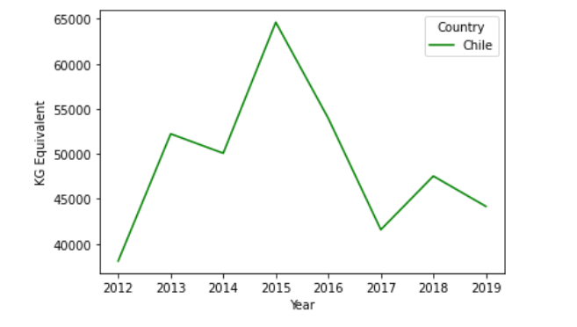
Cannabis seizure in Chile

Slide 10
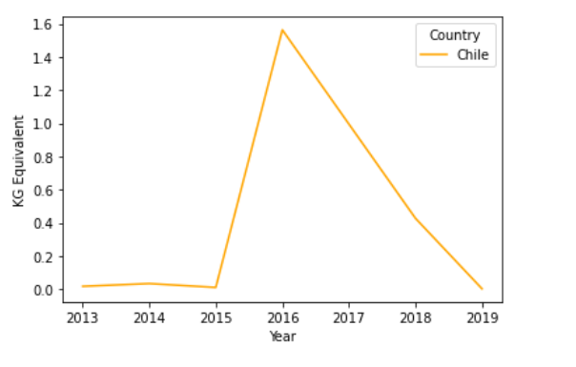
Opioids seizure in Chile

Slide 11
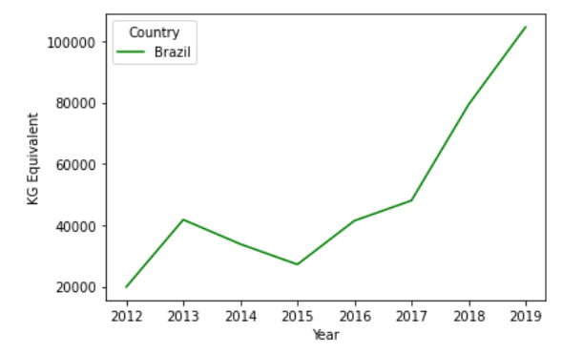
Cocaine seizure in Brazil

Slide 12
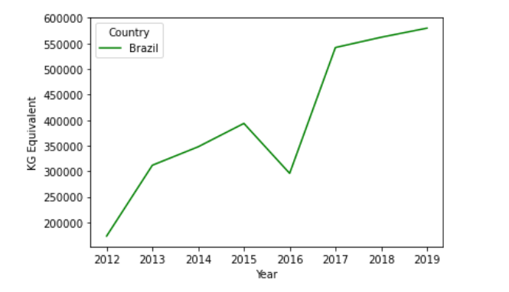
Cannabis seizure in Brazil

Slide 13
Cannabis seizure in Brazil

Slide 14
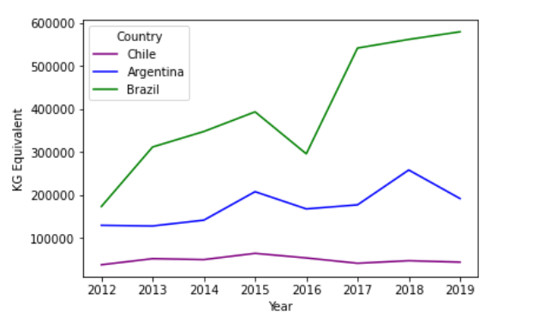
Comparing cannabis seizure

Slide 15
Despite this data...
Alcohol is a contributing or primary factor in many different chronic diseases, infectious diseases,
mental disorders, maternal and child health outcomes, injuries and poisonings, trauma, and social problems
According to the Global Burden of Disease Study, 2.8 million deaths were attributable to alcohol use in 2016. Alcohol use was the seventh leading global risk factor for disability adjusted life years (DALYs) in 2016, accounting for 1.6% of total DALYs among women and 6.0% of total DALYs among men

Slide 16
Despite this data...
The disability-adjusted life year (DALY) is a measure of overall disease burden, expressed as the number of years lost due to ill-health, disability or early death.

Slide 17
Despite this data...
research from the USA using the National Violent Death Reporting System (NVDRS) has demonstrated that 37% of male and 29% of female suicide decedents had positive blood alcohol (BAC) levels at the time of their death.

Slide 18
Despite this data...
The American Journal of Drug and Alcohol Abuse: An article examined the statistics on alcohol sales and death along with data from surveys on patterns of drinking between 1977 and 1996. They found that per capita alcohol consumption, as well as percentage of daily drinkers, correlated significantly and positively with several types of mortality, including overall rates of suicide
Ramstedt (Drug and Alcohol Review) estimated that for every litre increase in alcohol consumption at the population level in Canada, suicide mortality rates increased 4% overall

Slide 19
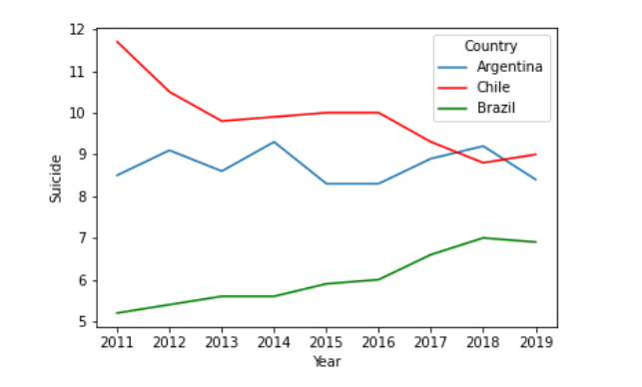
Suicides

Slide 20
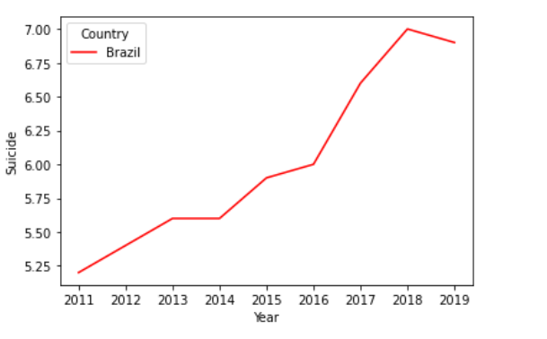
Suicides - Brazil

Slide 21
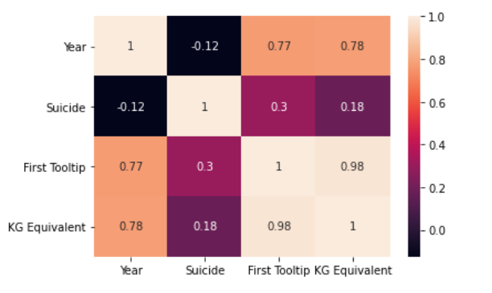
Argentina

Slide 22
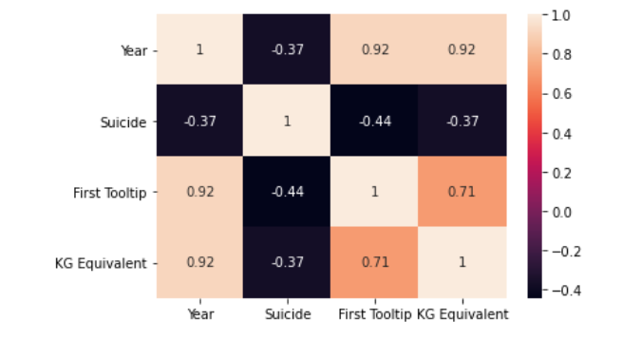
Chile

Slide 23
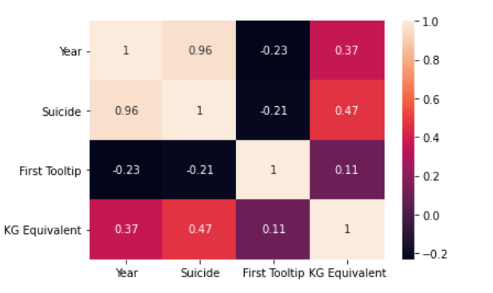
Brazil

Slide 24
https://revistas.udec.cl/index.php/gyap/article/view/5488
https://www.minsal.cl/sites/default/files/Programa_Nacional_Prevencion.pdf
https://injuryprevention.bmj.com/content/27/2/194
http://revistas.unla.edu.ar/saludcolectiva/article/view/3363 https://www.tandfonline.com/doi/full/10.1081/ADA-100107665
https://onlinelibrary.wiley.com/doi/abs/10.1080/09595230500170274
https://www.ncbi.nlm.nih.gov/pmc/articles/PMC8007116/
https://www.ncbi.nlm.nih.gov/pmc/articles/PMC7153138/pdf/3200843.pdf
https://ourworldindata.org/grapher/suicide-mortality-rate
https://dataunodc.un.org/

